Slide 1
Case Study Research
Dirk Riehle, Univ. Erlangen
NYT D05
Licensed under CC BY 4.0 International

Slide 2
Agenda
Case study research
Case study research design
Case study research execution
Case preparation
Data collection
Data analysis
Stopping criterion
Quality assurance

Slide 3
1. Case Study Research

Slide 4
Case Study Research
A case study is
An empirical in-depth investigation of
A contemporary phenomenon
In its real-world context
We use Yin (2009) here

Slide 5
Applicability of Case Study Research
Case study research can cope with situations in which
The phenomenon under investigation and its context aren’t easily separable
There will be many more variables of interest than data points

Slide 6
Properties of Case Study Research
Case study research
Uses multiple sources of evidence in order to triangulate results
Benefits from the prior development of theoretical propositions

Slide 7
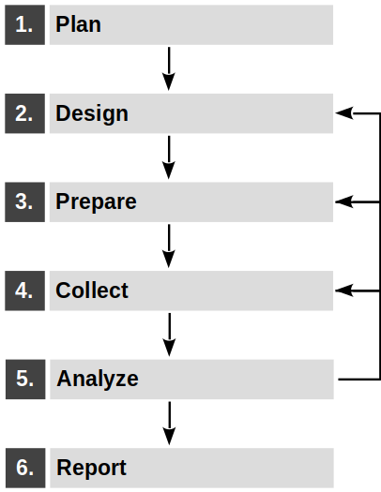
The Case Study Research Process
Case study research is linear yet iterative
Plan case study research
Design research
Prepare cases
Collect data
Analyze data
Report findings

Slide 8
When to Use Case Study Research [Y09]
 | Experiment | Survey | Archival analysis | History | Case study
Form of research question | How, why? | Who, what, how much? |  | How, why? | How, why?
Requires control of behavioral events | Yes | No | No | No | No
Focuses on contemporary events | Yes | Yes | No | Yes/no | Yes
Studies real-life context | No | No | No | No | Yes
Relies on one source of evidence | Yes/no | Yes | No | No | No

Slide 9
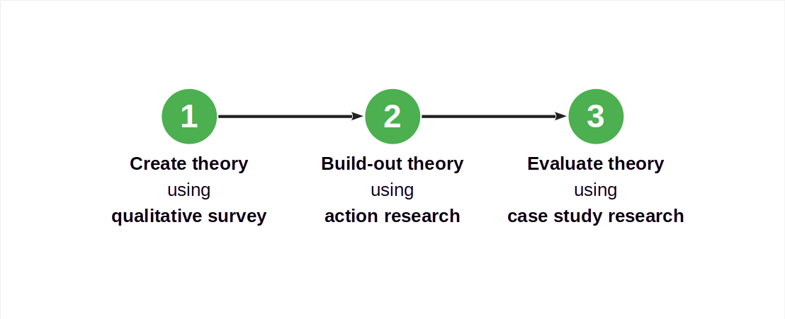
Case Study Research in a Larger Research Design

Slide 10
Exploration vs. Evaluation
Case study research can be used both for
Exploration
Evaluation
Both are a form of building out your theory

Slide 11
2. Case Study Research Design

Slide 12
Case Study Research Design
Components of a case study research design
The research questions
The propositions, if any
The unit(s) of analysis
The data-to-proposition linking logic
The interpretation criteria

Slide 13
Example CSR Problems in PLE Research Questions [1]
Research question (study question)
What are current problems in product-line engineering (PLE) and why?
No specific propositions (hypotheses)
[1] Riehle, D., Capraro, M., Kips, D. & Horn, L. (2016). Inner Source in Platform-Based Product Engineering. IEEE Transactions on Software Engineering vol. 42, no. 12, pp. 1162-1177.

Slide 14
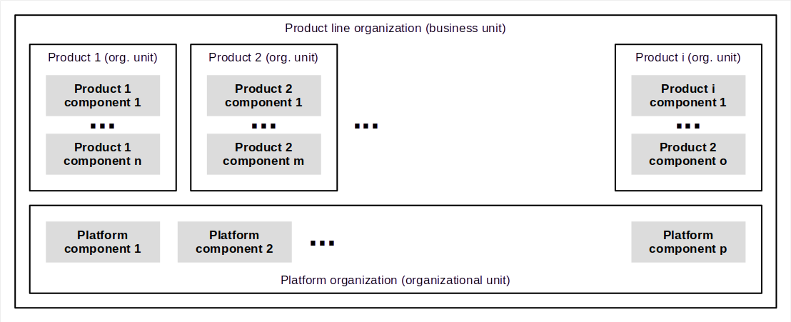
Product-Line Engineering

Slide 15
Unit of Analysis
A unit of analysis is
A construct being analyzed
Units of analysis can be
Tangible (e.g. people, products)
Intangible (e.g. theoretical constructs like group dynamics)
In the simplest case (no pun intended), the case is the unit of analysis

Slide 16
Example CSR Problems in PLE Units of Analysis
(Potential) units of analysis
The overall business unit
The product organizational units
The platform organizational unit
The business unit leader
Engineering managers
Architects / developers

Slide 17
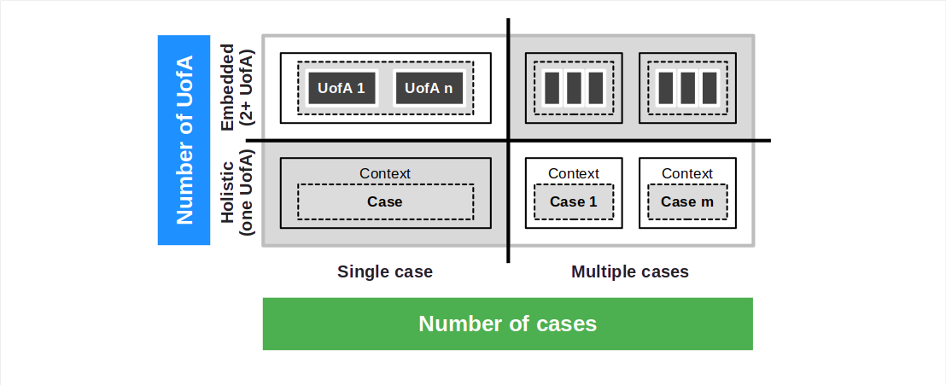
Dimensions of Case Study Research Design 2 / 2

Slide 18
Single-Case Case Study Research
Types of single-case case study research according to Yin (2009)
Special cases
The critical case
The unique / extreme (rare and/or particularly interesting) case
The revelatory case
The typical (representative) case
The longitudinal case

Slide 19
Multiple-Case Case Study Research
Case replication
Literal replication to strengthen findings
Theoretical replication to contrast and extend findings
Purposive sampling (not statistical sampling)

Slide 20
Exploration vs. Evaluation Revisited
Exploratory case study research prefers
Theoretical replication to go broad
Evaluatory case study research preferes
Literal replication to go deep

Slide 21
Example Multiple-Case CSR Design With Replication Logic
 |  | Inner source approach (IS)
 |  | Unit of analysis 1, case 1 | Unit of analysis 1, case 2 | Unit of analysis 1, case 3
Dedicated organization approach (DO) | Unit of anal- ysis 2, case 1 | [1] Direct comparison of IS and DO from case 1 | [a] Cross-case 1 + 2 IS analysis | [b] Cross-case 1 + 3 IS analysis
 | Unit of anal- ysis 2, case 2 | [x] Cross-case 1 + 2 DO analysis | [2] Direct comparison, [i] Replication of case 1 | Not planned
 | Unit of anal- ysis 2, case 3 | [y] Cross-case 1 + 3 DO analysis | Not planned | [3] Direct comparison, [ii] replication of case 1 + 2
Direct comparison = [1], [2], [3] Cross-case unit-of-analysis comparisons = [a], [b], and [x], [y] Replication of case analyses = [i], [ii]

Slide 22
3. Case Study Research Execution

Slide 23
Case Study Research Execution
During execution, you iterate over
Prepare cases
Collect data
Analyze data
Until a stopping criterion is reached

Slide 24
3. Prepare
Goal
Prepare for how to gather the data
Document procedures in case study protocol
Consider research ethics
Gain ethics committee approval
Discuss researchers' conflicts of interests, subjective views
Conduct pilot case study
Refine data collection plans, spot holes
Choose pilot case for convenience, access, geographic proximity

Slide 25
3. Prepare: Case Study Protocol (1)
Definition of case study protocol
Structured guidance for data gathering
Includes procedures, interview questions, etc.
Purpose of case study protocol
Increase effectiveness, focus, reduce error
If followed properly, improves case study reliability

Slide 26
3. Prepare: Case Study Protocol (2)
Suggested case study protocol structure [Y09]
Section A: Overview of the case study design, context
Objectives, research questions
Background literature, readings
Section B: Data gathering procedures
Strategy for protecting human subjects
Identification of likely sources of data (identification of interviewees)
Logistical reminders
Section C: Data collection questions
Fine-grained questions for the researcher to keep in mind
Link of questions to data sources
Section D: Guide for case study report
Requirements to the data to enable later report of the findings

Slide 27
4. Stopping Criterion

Slide 28
5. Quality Assurance

Slide 29
4. Collect
Follow the case study protocol
The four principles of data collection [Y09]
Use multiple sources of evidence
See last weeks remarks on triangulation
Create a case study database
Arranges collected evidence, researchers' interpretation
Can be shared as part of reporting
Maintain a chain of evidence
Increases reliability of results
Exercise care when using data from electronic sources
Information overload; cheap collection, expensive analysis
Incorrect claims about authorship in social networks

Slide 30
4. Collect: Data Sources (1)
Interviews
Discussion about a topic following a guideline (structured) or not (unstructured)
Strengths:
Targeted to case study research question
Provides deep explanations and personal views of interviewees.
Weaknesses
Bias to poorly articulated questions
Response bias (tendency to give wrong answers, e.g. answers that are socially acceptable)
Reflexivity bias (interviewer gives what researcher wants to hear)

Slide 31
4. Collect: Data Sources (2)
Direct observations
Observation of a phenomenon by the research, e.g. “shadowing” an individual
Strengths:
Covers actions in real time
Cover case's context
Weaknesses:
High costs / time investment
Potential reflexivity bias

Slide 32
4. Collect: Data Sources (3)
Participant observations
Observation from the role of a participant, e.g. joining as a worker in a studied company
Strengths:
Insights into interpersonal behavior
Same as for observations
Weaknesses:
Bias due to manipulation of events,
Same as for direct observation

Slide 33
4. Collect: Data Sources (4)
Documentation
Letters, calendars, meeting minutes, administrative documents, progress reports, written reports
Strengths:
Stable
Specific (with a lot of details)
Can deliver historical insights
Weaknesses:
Selection bias
Retrievability, getting access
Reporting bias

Slide 34
4. Collect: Data Sources (5)
Archival records
Records form government archives, case internal archives (e.g. configuration management systems)
Strengths:
Stable
Specific (with a lot of details)
Can deliver historical insights
Weaknesses:
Selection bias
Retrievability, getting access
Reporting bias

Slide 35
4. Collect: Data Sources (6)
Physical artifacts
Works of art, tools and devices, buildings, office space

Slide 36
Example of 4. Collect
Interview
Performed 3 interviews per case
Direct observations
Observed 3 to 5 workshops for two cases
Did not perform direct observations for one case
Documentation
Reviewed process documentation and training materials

Slide 37
5. Analyze
Use theoretical propositions
Search evidence to (in-)validate propositions
Work data from the “ground up”
Alternative to “relying on theoretical propositions”
Search for patterns and analyze using appropriate research methods
Develop a case description
Organize case study data according to a preexisting descriptive framework
Fallback solution if other methods don’t work
Examine rival explanations
Try to define and test rival explanations to the ones identified in the analysis

Slide 38
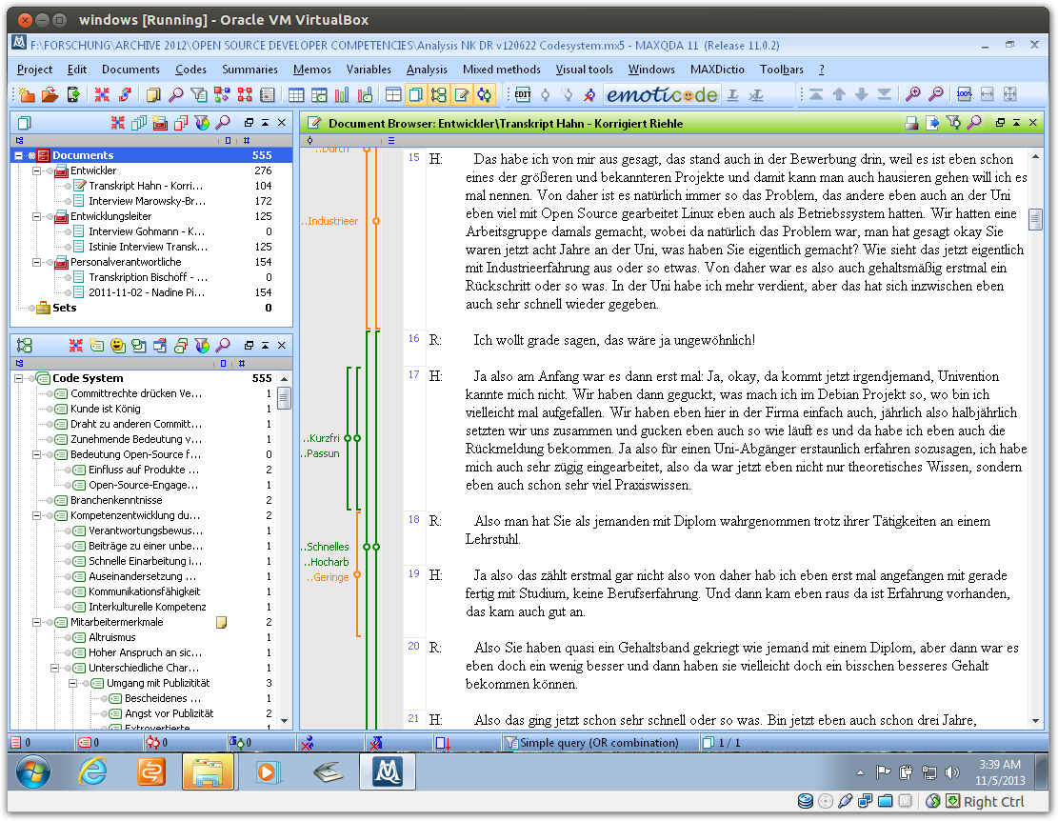

Slide 39
Case Studies in Theory Evaluation (2)
Theory to evaluate is postulated as framing theory in study design (phase 2)
Guidelines for case studies in theory evaluation [Y09]
Triangulate evidence from multiple types of sources
Mix contrary methods, orientations (realist/relativist, qualitative/quantitative)
Give much focus to discussion rival explanations / theories

Slide 40
Thank you! Any questions?
dirk.riehle@fau.de – https://oss.cs.fau.de
dirk@riehle.org – https://dirkriehle.com – @dirkriehle

Slide 41
Legal Notices
License
Licensed under the CC BY 4.0 International license
Copyright
© Copyright 2012-2023 Dirk Riehle, some rights reserved

